Slide 1
Unit 19
Types of Heat Exchangers
30th.Nov.2018

Slide 2
WORDS AND EXPRESSIONS
Passage n. 通道,通过
---long narrow way
A long narrow area with walls on either side that connects one room or place with another [syn] corridor
@a secret underground passage 秘密的地下通道
@A dark narrow passage led to the main hall 一条又暗又窄的走廊通往大厅
---in the body
A tube in the body through which air, liquid, etc. passes
@blocked nasal passages 阻塞的鼻管儿

Slide 3
---section from a book
A short section from a book, piece of music, etc.
@read the following passage and answer the questions below.
---Journey by ship 海航
A journey from one place to another by ship
@her father had worked his passage (=worked on a ship to pay for his journey) to America.
---going through 通过,穿过
①a passage through sth= a way through sth 穿过某物的通道
@the officers forced a passage through the crowd. 警察在人群中开辟出一条通道
---the action of going across, through or past sth 穿过,穿越
@the large trees may obstruct the passage of light.

Slide 4
Versatile a. 多用途的,通用的
---(of a person) able to do many different things 多才多艺的
@he is a versatile actor who has played a wide variety of parts.
---(of food, a building,etc.) having many different uses
多用途的
@eggs are easy to cook and are an extremely versatile food
Versatility n.
@ she is a designer of extraordinary versatility.

Slide 5
Proprietary a. 所有的,专有的,私有的
---(of goods) made and sold by a particular company and protected by a registered trademark
(由特定公司生产并销售,并受注册商标保护的)专卖的,专营的,专利的
@ a proprietary medicine专卖药物
@Proprietary brands 专利品牌
--- relating to an owner or to the fact of owning sth 所有的
@the company has a proprietary right to the property. 该公司对这些财产有所有权.

Slide 6
Corrugate v. 成波纹状,起波纹
注意:corrugated
@ a corrugated iron roof

Slide 7
Groove
--- a long narrow cut in the surface of sth hard 沟,槽,辙,纹
比较: slit

Slide 8
Coefficient n. 系数
---(mathematics) a number which is placed before another quantity and which multiplies it , for example 3 in the quantity 3x
---(physics) a number that measures a particular property(= characteristic) of a substance
@ the coefficient of fraction/expansion
(=fraction factor)

Slide 9
Gasket n. 密封垫片,衬垫
---a flat piece of rubber, etc. placed between two metal surfaces in a pipe or an engine to prevent steam, gas or oil from escaping.
Foul v. 弄赃,阻塞
---to make sth dirty, usually with waste material
污垢系数 fouling factor

Slide 10
Sanitation n. 卫生,卫生设备
---the equipment and systems that keep places clean, especially by removing human waste
@ disease resulting from poor sanitation

Slide 11
Pharmaceutical a. 制药的,药物的
a.---(only before noun )
connected with making and selling drugs and medicines
@ pharmaceutical companies
the pharmaceutical industry
n.---(usually pl.)(technical)
A drug or medicine
@ the development of new pharmaceuticals
@ the pharmaceuticals industry

Slide 12
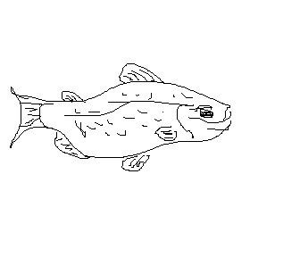
Countercurrent =counter flow 逆流
Fin n. 翅片 v.装翅片
---a thin flat part that stick out from the body of a fish, used for swimming and keeping balance
Dorsal fin
Tail fin
fin
scales

Slide 13
Militate v.妨碍,起作用
---militate against sth
To prevent sth; to make it difficult for sth to happen or exist
@the supervisor’s presence militated against a relaxed atmosphere.

Slide 14
Cryogenic a. 冷冻的,低温的
---(technical) involving the use of very low temperatures
@ a cryogenic storage system 低温储存系统

Slide 15
Recovery n. 恢复,回收,再生
--- recovery from sth
The process of becoming well again after an illness or injury
@his father has made a full recovery from the operation.
--- recovery in sth
The process of improving or becoming stronger again
@the government is forecasting (预测) an economic recovery.
@a recovery in consumer spending
@the economy is showing signs of recover.

Slide 16
--- recovery of sth
The action or process of getting sth back that has been lost or stolen 收回;取回;复得
@there is a reward(酬金) for information leading to the recovery of missing diamond.
--- also “recovery room”
The room in a hospital where patients are kept immediately after an operation监护室
@your mother is now in recovery.

Slide 17
Gland n. 填料盖,密封套

Slide 18
Sag v. 下垂,下沉
---to hang or bend down in the middle, especially of weight or pressure
@ a sagging roof
@your skin starts to sag as you get older.
@ the tent began to sag under the weight of the rain.
--- to become weaker or fewer 下降,减少

Slide 19
Annulus n. 环状空间
Annular a. 环形的
De wax v. 脱蜡
Wax the floor wax the car
Crystallization n.结晶,结晶体

Slide 20
Stack n. 堆积;烟囱(chimney)
Eg. A stack of plates
stack of money 许多钱
--- 尤其是指工厂的大烟囱

Slide 21
Inherent a. 内在的,固有的
--- inherent in sb/sth
That is a basic or permanent part of sb/sth and that can not be removed
[syn] intrinsic (本身的,本质的)
@the difficulties inherent in a study of this type
@ violence is inherent in our society.
@ an inherent weakness in the design of the machine.
Adv. Inherently

Slide 22
Accommodate v. 调节,适应,容纳
--- to provide sb with a room or place to sleep, live or sit
@ the hotel can accommodate up to 500 guesses.
--- to provide enough space for sb/sth
@over 70 minutes of music can be accommodated on one CD.

Slide 23
--- to consider sth, such as sb’s opinion or a fact, and be influenced by it when you are deciding what to do or explaining sth顾及,考虑到
@ our proposal tries to accommodate the special needs of minority groups. (少数民族,少数的群体)
--- accommodate sb with sth 给…帮忙
To help sb by doing what they want [syn] oblige (帮忙)
@I have ~ed the press a great deal, giving numerous interviews.

Slide 24
text
1-1
Heat exchangers are equipment primarily for transferring heat between hot and cold streams. They have separate passages for the two streams and operate continuously. The most versatile and widely used exchangers are the shell-and-tube types, but various plate and other types are valuable and economically or superior in some applications.

Slide 25
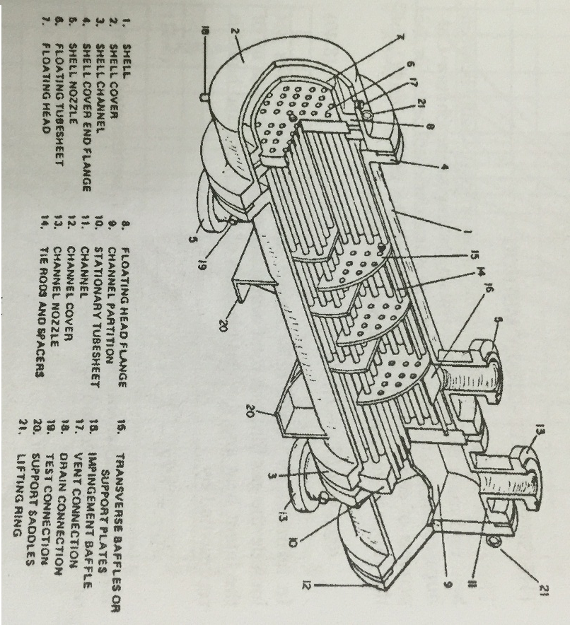

Slide 26
1-2
These other types will be discussed briefly, but most of the space following will be devoted to the shell-and-tube types, primarily because of their importance, but also because they are most completely documented in the literature. Thus they can be designed with a degree of confidence to fit into a process. The other types are proprietary and for the most part must be process designed by their manufacturers.

Slide 27
1
换热器是主要用于冷热流束间传递热量的设备.对于两种流体而言,具有单独的通道,并且连续操作.功能最多,且广泛使用的换热器是管壳式换热器,但各种板式及其他类型的换热器也有其价值, 在某些使用中具有经济性和优势.这些其他类型的换热器将概括讨论,而接下来的大部分篇幅将涉及管壳式的, 主要因为他们即重要,又因为在文献中他们大部分具有最完整的记录.于是我们就有把握设计出与过程相匹配的管壳式换热器.其他形式的换热器是带有专利性的,且大部分必须由他们制造商进行工艺设计.

Slide 28
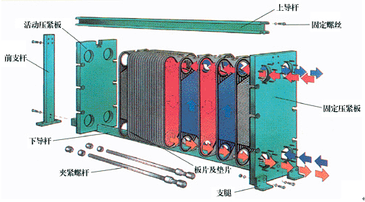
Moving hold-down plate
Upper guided rod
Fixed bolt
Fixed hold-down plate
Support leg
Corrugated plate & gasket
Clamping bolt
Down guided rod
Front fixing bar

Slide 29
2-1
Plate-and-frame exchanger
Plate-and-frame exchangers are assemblies of pressed corrugated plates on a frame. Gaskets in grooves around the periphery contain the fluid and direct the flows into and out of the space between the plates. Close spacing and the presence of the corrugations results in high coefficients on both sides several times those of shell-and-tube equipment and fouling factors are low.

Slide 30
2-2
The accessibility of the heat exchanger surface for cleaning makes them particularly suitable for fouling services and a high degree of sanitation is required, as in food and pharmaceutical processing. Operating pressures and temperatures are limited by the natures of the available gasketing materials, with usual maxima of 300 psi and 400 °F

Slide 31
2
板框式换热器
板框式换热器是由压制成型的波纹板组装在一框架上而形成的(被压成波纹状的板子安装在框架上组装成的.).在周边槽里的垫片对流体起密封作用并引导流体进出板间的空隙.密闭的空隙和波纹的存在使两边具有很高的传热系数,是管壳式设备的几倍,并且污垢系数低.换热器表面可以清洗,使得板框式换热器特别适合于易结垢和卫生要求高的场合,如在食品及制药工艺中.操作压力和操作温度受到可用垫片材料特性的限制,通常最大为300psi和400°F.

Slide 32
3
Since plate-and-frame exchangers are made by comparatively few concerns, most process design information about them is proprietary but may be made available to serious engineers. Fraction factors and heat transfer coefficients vary with the plate spacing and the kinds of corrugations. Pumping costs per unit of heat transfer are said to be lower than for shell-and-tube equipment. In stainless steel construction, the plate-and-frame construction cost is 50% ~ 70% that of shell-and-tube.

Slide 33
3
由于较少企业制造板框式换热器,大多数关于板框式换热器的工艺设计资料是专利性的,但也许可以提供给负责任的工程师.摩擦系数和传热系数随着板间距和波纹形状而变化.(每单位的传热的泵送成本)传递单位热量的泵送费用要比管壳式设备低.在不锈钢结构在中,板框式换热器结构的成本是管壳式设备的50% ~ 70% .

Slide 34
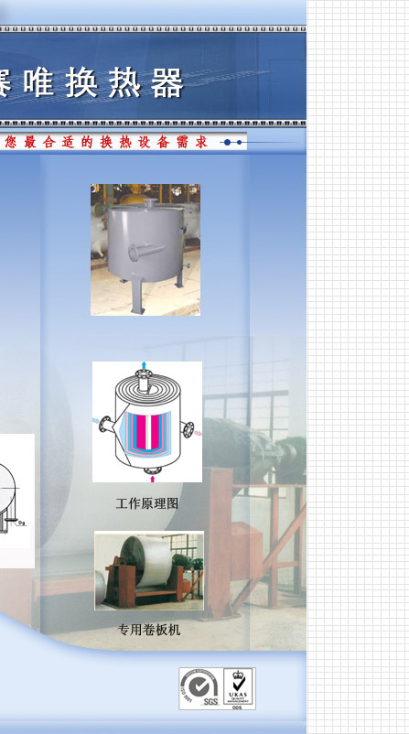

Slide 35
4-1
Spiral heat exchangers
In spiral heat exchangers, the hot fluid enters at the center of the spiral element and flows to the periphery; flow of the cold liquid is countercurrent, entering at the periphery and leaving at the center.

Slide 36
4-2
Heat transfer coefficients are high on both sides, and there is no correction to the log mean temperature difference because of the true countercurrent action. These factors may lead to surface requirements 20% or so less than those of shell-and-tube exchangers. Spiral types generally may be superior with highly viscous fluids at moderate pressures.

Slide 37
4
螺旋式换热器
在螺旋式换热器中,热流体从螺旋元件的中心进入,向周边流动,冷流体的流动是逆流的,从周边进入,且在中心流出.两边的传热系数高,并且由于真正的逆流作用,不需要对对数平均温差进行修正.由于这些因素的原因可能使所需面积比管壳式换热器的面积少20%左右.对于中压下的高黏度流体,螺旋板式换热器通常具有优势..(螺旋式换热器通常以高黏度流体在中压下而突显优势.)

Slide 38
5-1
Compact (plate-fin) exchangers
Compact exchangers are used primarily for gas service. Typically they have surfaces of the order of 1200 m2/m3, corrugation height 3.8~11.8 mm, corrugation thickness 0.2~0.6mm, and fin density 230~700 fins/m.

Slide 39
5-2
The large extended surface permits about four times the heat transfer rate per unit volume that can be achieved with shell-and-tube construction. Units have been designed for pressures up to 80 atm or so. The close spacing militate against fouling service. Commercially, compact exchangers are used in cryogenic services, and also for heat recovery at high temperatures in connection with gas turbines.

Slide 40
5-3
For mobile units, as in motor vehicles, compact exchangers have the great merits of compactness and light weight. Any kind arrangement of cross and countercurrent flows is feasible, and three or more different streams can be accommodated in the same equipment. Pressure drop, heat transfer relations, and other aspects of design are well documented.

Slide 41
5
紧凑式(板翅式)换热器
紧凑式换热器主要用于气体的场合.典型的紧凑式换热器具有每立方米1200平方米量级的换热表面,波纹高度在3.8~11.8mm之间,翅片密度为230~700个翅片/m,大量的扩展表面使每单位体积提供的传热速率大约是管壳式结构的4倍. 已经设计出了压力达到80atm左右的设备.密闭的空隙不利于结垢场合的使用.从工业上,紧凑式换热器用于低温场合,以及与气动透平机相连接以达到在高温下的热量回收的目的.在运动装置中,如在机动车辆里,紧凑式换热器有紧凑、重量轻等突出优点。错流和逆流的任何排列形式都是可行的，在同一设备中可以容纳三种或更多流束。压力降，传热关系，及设计的其他方面都有很好的记录（都有成熟的资料可查）。

Slide 42
6
Air coolers
In such equipment the process fluid flows through finned tubes and cooling air is blown across them with fans. The economics of application of air coolers favors services that allow 25~40°F temperature difference between ambient air and process outlet. In the range above 10 Mbut/hr, air coolers can be economically competitive with water coolers when water of adequate quality is available in sufficient amount.

Slide 43
6
空冷器
在这类设备中，过程流体从安装了翅片的管子里流动，冷却气在风扇作用下横向吹过。当周围温度与过程出口温差在25~40°F范围内，空冷器的应用具有经济性，在传热速率超过10 Mbut/hr时，空冷器与水质满足要求且供应量充足时的水冷器在经济性上不相上下。

Slide 44
7-1
Double-pipe exchangers
This kind of exchanger consists of a central pipe supported within a larger one by packing glands. The straight length is limited to a maximum of about 20ft; otherwise the center pipe will sag and cause poor distribution in the annulus.

Slide 45
7-2
It is customary to operate with the high pressure, high temperature, high density, and corrosive fluid in the inner pipe and the less demanding one in the annulus. The inner surface can be provided with scrapers as in de-waxing of oil or crystallization from solutions.

Slide 46
7-3
External longitudinal fins in the annulus space can be used to improve heat transfer with gases or viscous fluids. When greater heat transfer surfaces are needed, several double-pipes can be stacked in many combination of series or parallel.

Slide 47
7
套管换热器
这类换热器由中心管通过填料密封盖支撑在一个较大的管内构成。直管长度最大限制在20ft，否则中心管将下沉，并造成环隙内流体分布不均。通常在内管走高温，高压，高密度以及腐蚀性流体，而对环隙中流体的要求降低。可以给内表面安装刮板，就象石油脱蜡或溶液结晶的情况。环隙中的外部轴向翅片能改善气体或粘性流体的传热。当需要更大的传热表面时，可以把几个套管以串连或并联的组合形式叠加在一起。

Slide 48
8
Double-pipe exchangers have largely lost out to shell-and-tube units in recent years. They may be worth considering in these situations:
When the shell-side coefficient is less than half that of the tube-side; the annular side coefficient can be made comparable to the tube side.
Temperature crosses that require multishell shell-and-tube units can be avoided by the inherent true countercurrent flow in double-pipes.
High pressures can be accommodated more economically in the annulus than they can in larger diameter shell.
At duties requiring only 100~200 sqft of surface the double-pipe may be more economical, even in comparison with off-the-shell units.

Slide 49
8
套管换热器近些年已经大量的为管壳式换热器所取代。以下情况可以考虑使用该类换热器。
1、当壳程侧传热系数不足管程侧的一半时，环侧传热系数可以与管侧相当。
2、由于本质上是真实逆流，套管换热器能避免多壳程换热器所出现的温度交叉。
3、承受高压时，套管可以比大直径壳体更为经济。
4、在只需要100~200 平方英尺表面的负载情况下，套观换热器更经济，即使是和专有(即不需要定制的)相比。

